Slide 1

A look into Artificial intelligence
HUNG NGUYEN
An introduction to Artificial Intelligence and a detailed process of building an AI model

Slide 2
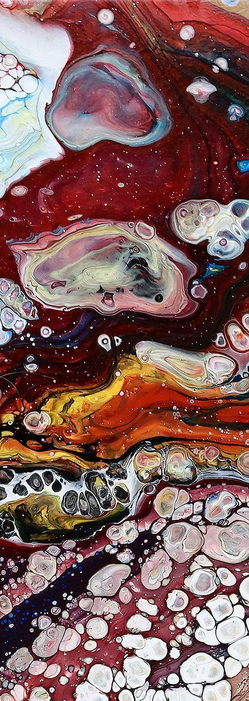




ABOUT ME
Nguyễn Phú Hưng
Software Engineering Student
Experiences:
Machine Learning Course –
Foundation Machine Learning / Deep Learning Course –
Data Science Intern –
Intensive Amount of Searching –

Slide 3

PURPOSES
To give an idea about:
What Artificial Intelligence actually is
What lies in the field for AI
What a process of building an AI model looks like
What you need to be an AI developer

Slide 4
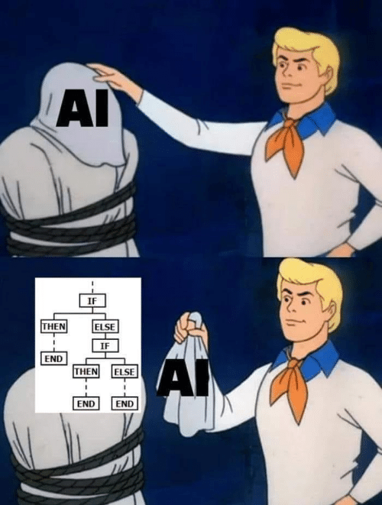

Slide 5
Contents
What is AI ?
What Lies in the Field of AI ?
2.1. Types of AI
2.2. Fields that Apply AI
2.3. Tools to Actualize AI
Making a Real AI
What You Need to be an AI Developer
Q & A

Slide 6

1. What is ai ¿

Slide 7
definition
Minsky and McCarthy:
"any task performed by a program or a machine that, if a human carried out the same activity, we would say the human had to apply intelligence to accomplish the task"

Slide 8
But What is intelligence ¿

Slide 9

Slide Title
“The question of whether a computer can think is no more interesting than the question of whether a submarine can swim.” – Edsger W. Dijkstra

Slide 10
conclusion
Artificial Intelligence can be seen as:
whatever made by human
that has some kind of intelligence
but not too simple

Slide 11
2. What lies in the field of ai ¿

Slide 12
2.1. types of ai

Slide 13
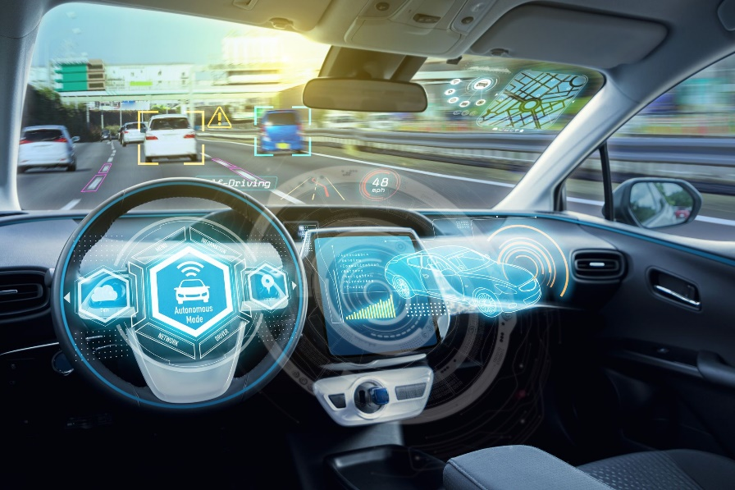
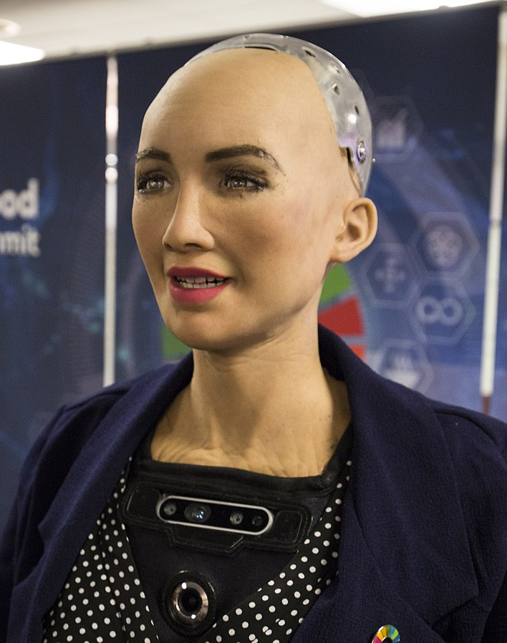
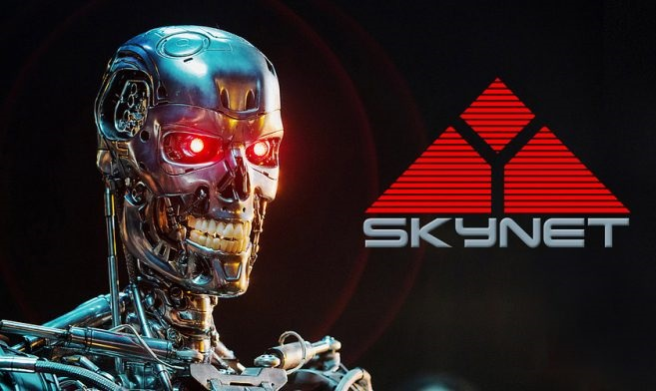
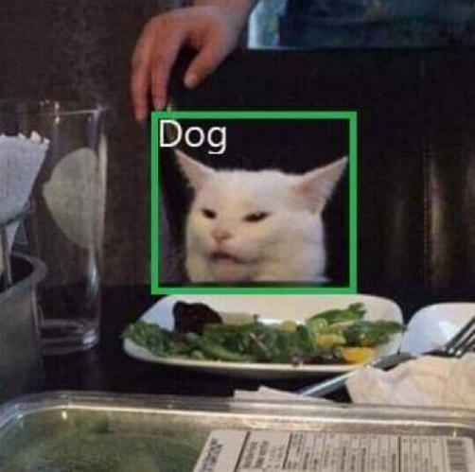
WEAK / NARROW AI | STRONG / GENERAL / SUPER AI
Focus on one narrow task | Perform tasks on its own like a human being or even better
Every existing AI falls into this | Not existed yet

Slide 14
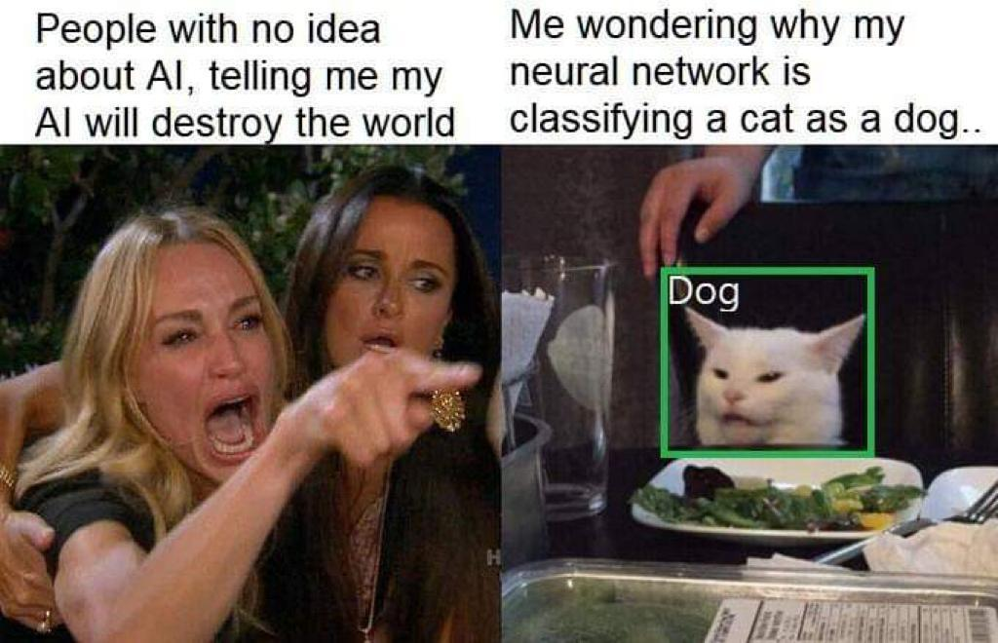

Slide 15
2.2. Fields that apply ai

Slide 16

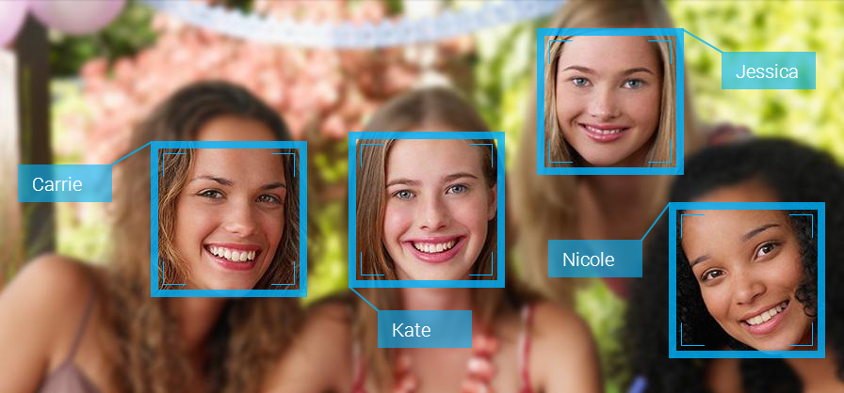


Natural Language Processing | Computer Vision
Automation | Data Analytics

Slide 17
2.3. Tools to actualize ai

Slide 18
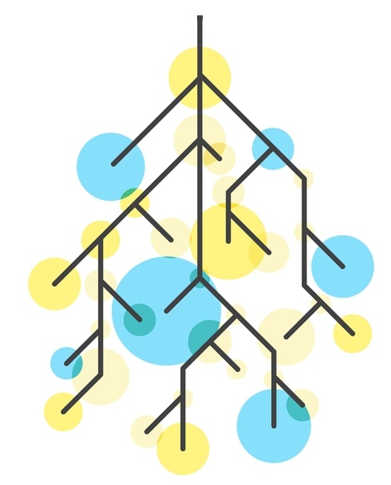
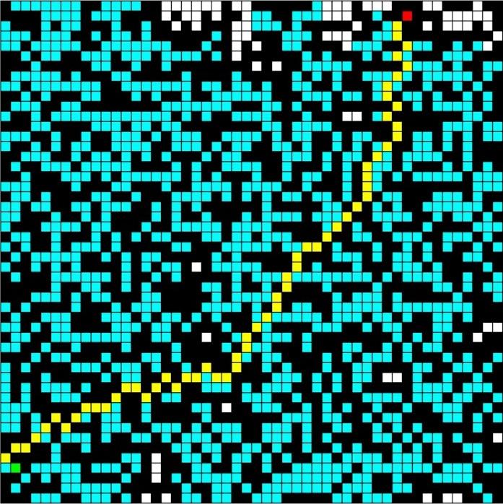
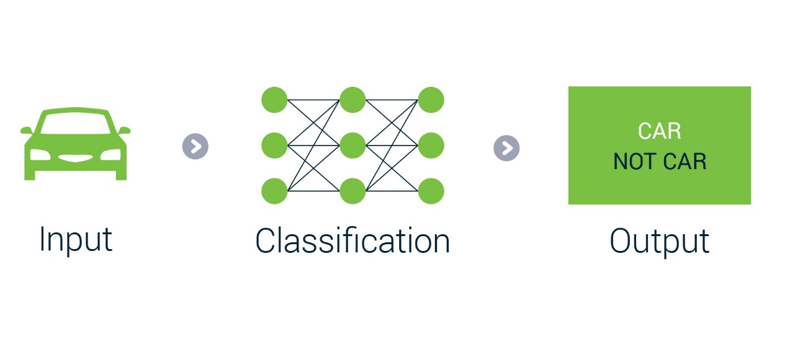
NON-LEARNING METHODS | LEARNING METHODS
“Hard-coded” | Learn from experiences
Decision trees, searching algorithms | Machine learning

Slide 19

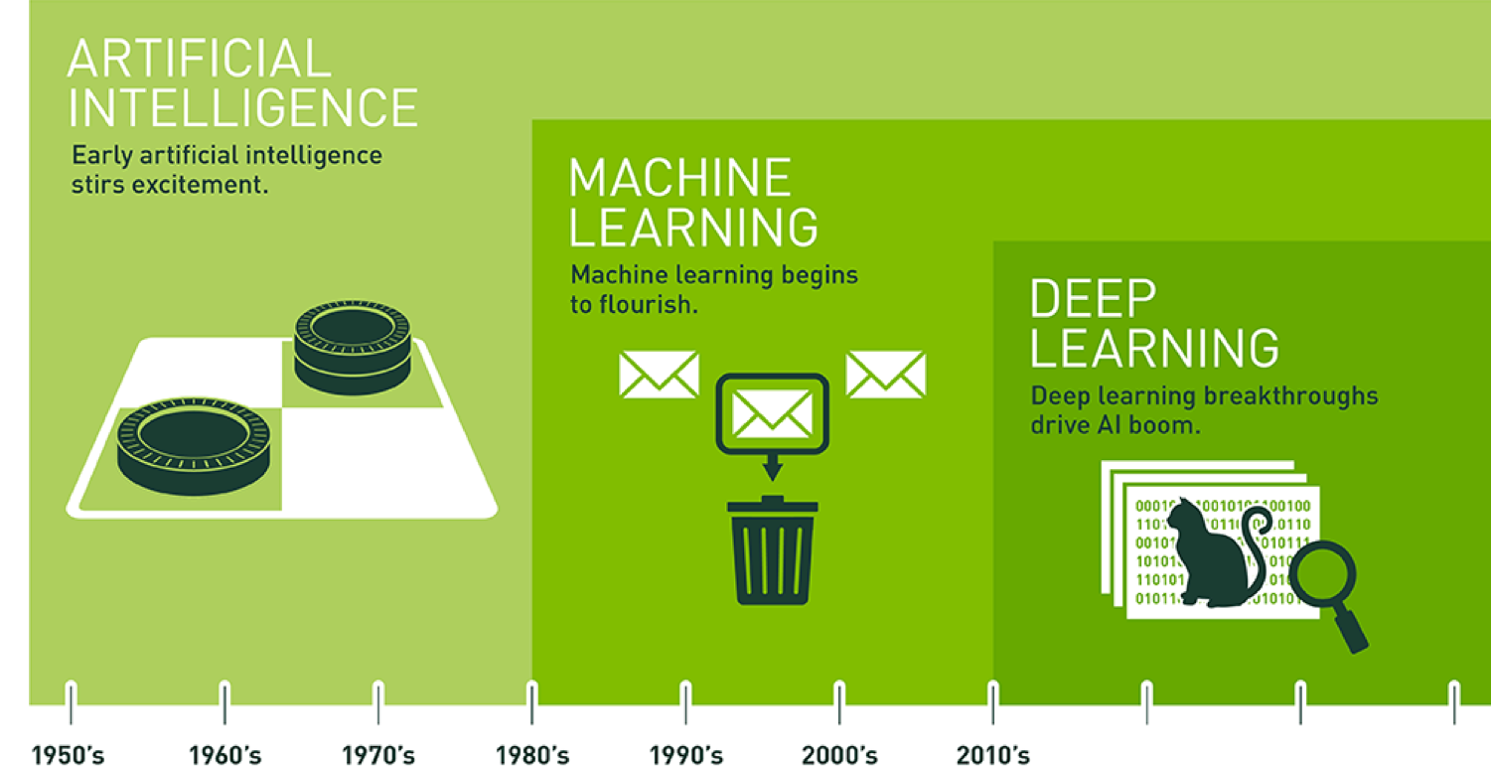

Slide 20
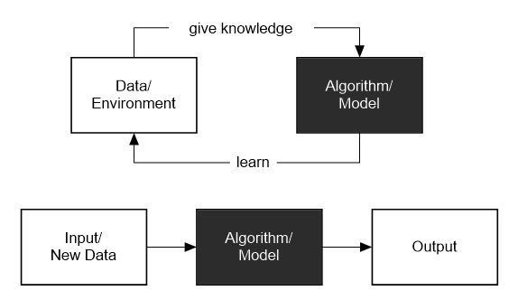
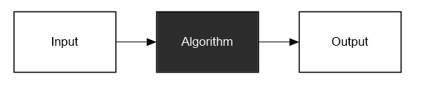
NON-LEARNING ALGORITHM | MACHINE LEARNING

Slide 21
3. Making a real ai

Slide 22
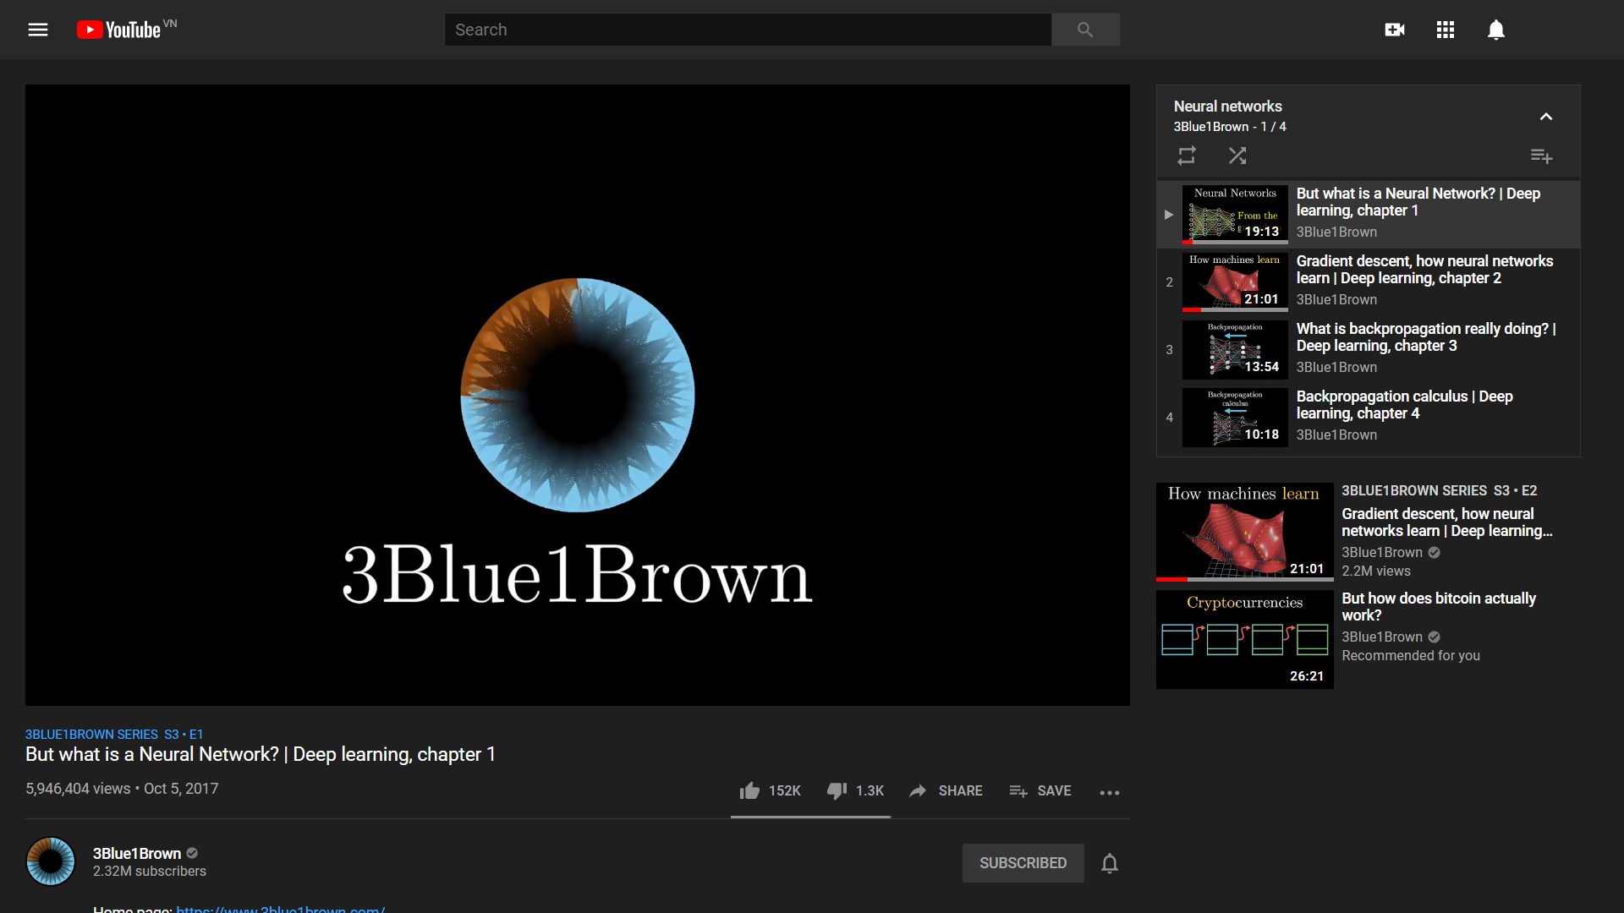

Slide 23
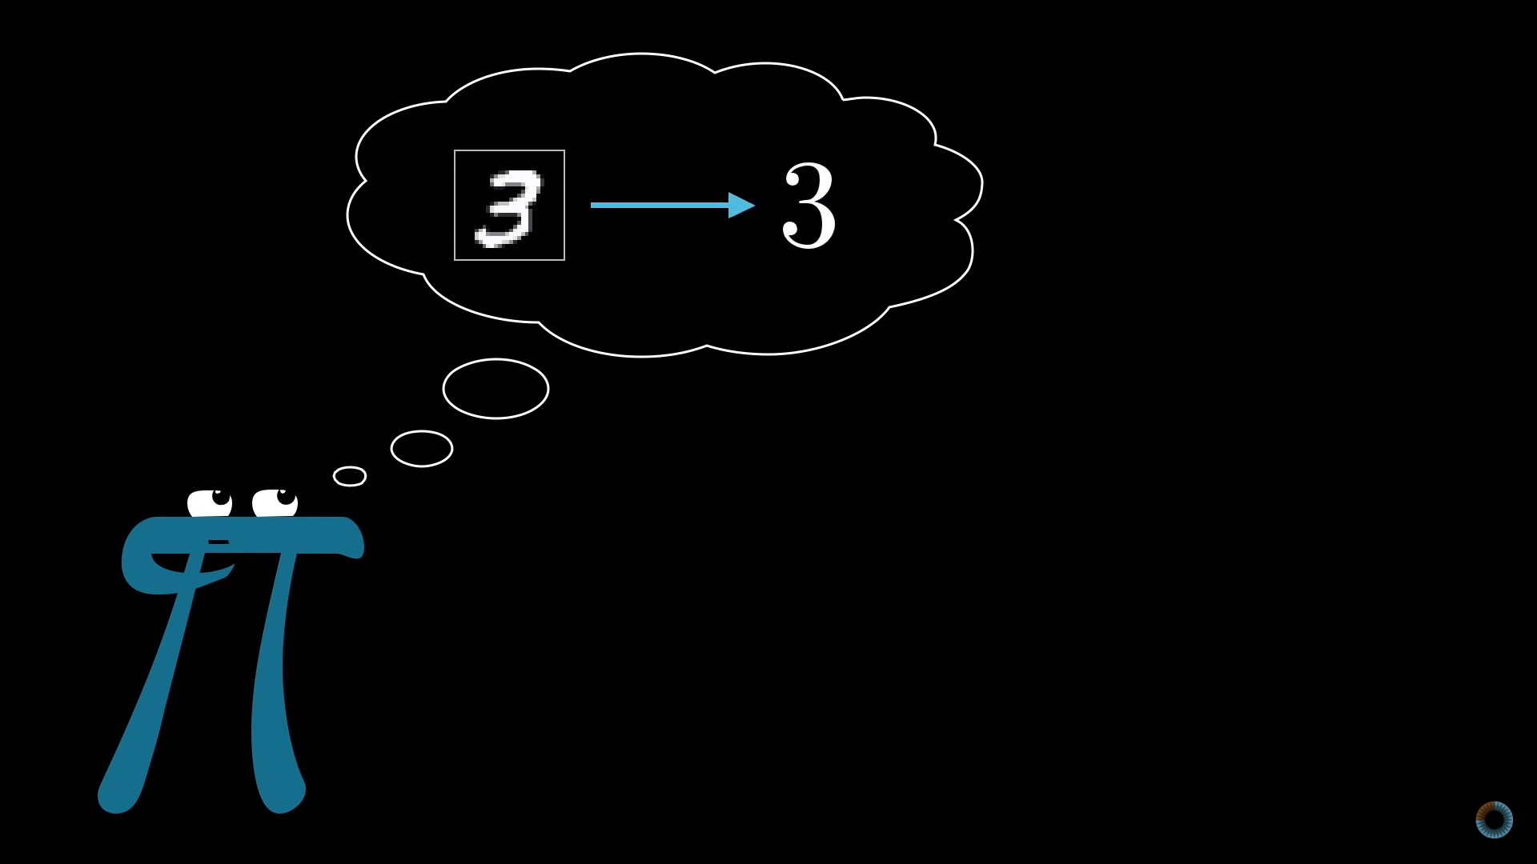

Slide 24
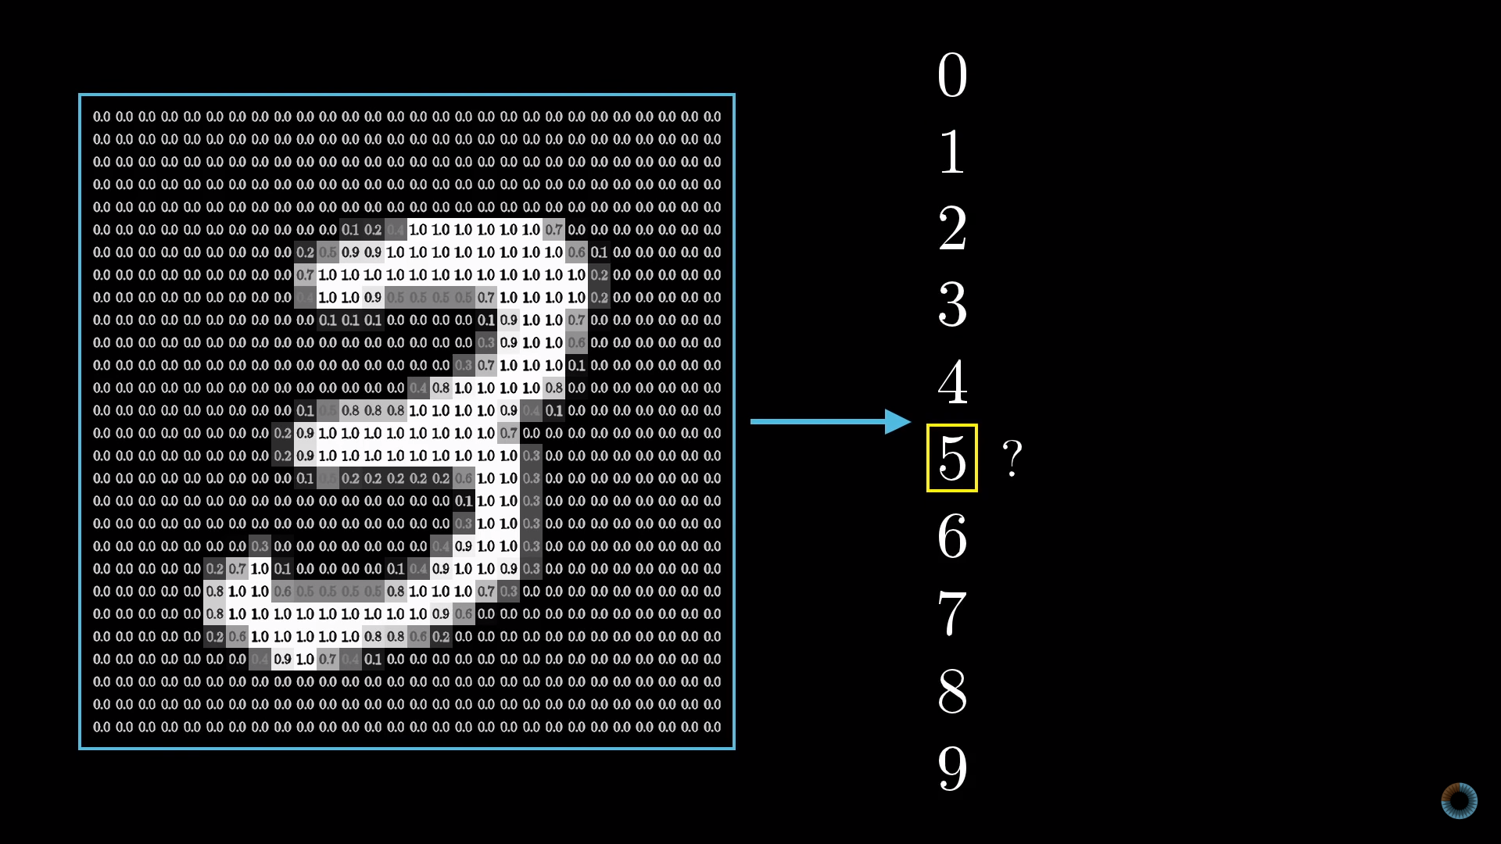

Slide 25
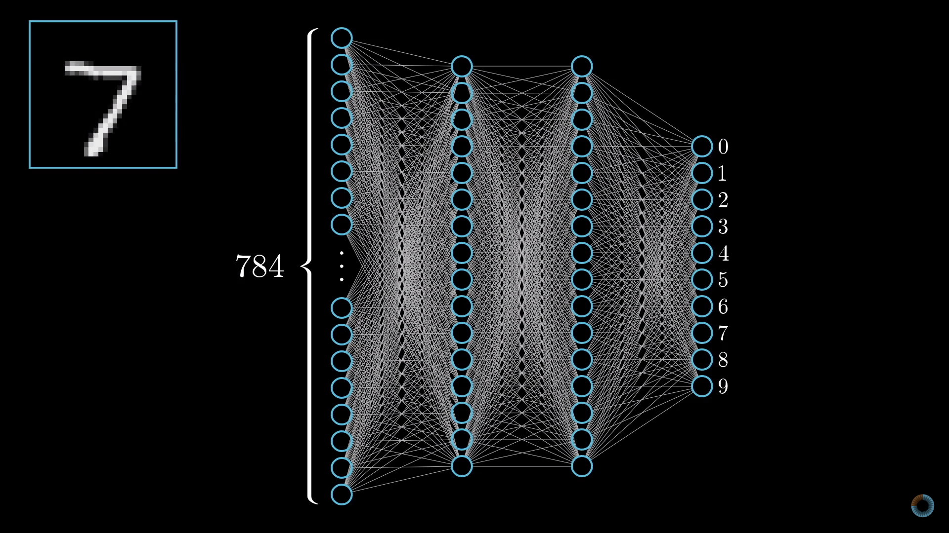

Slide 26
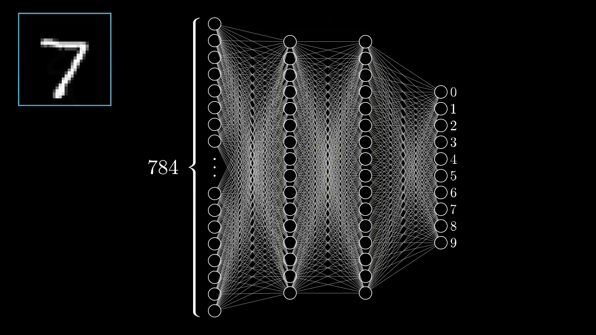

Slide 27
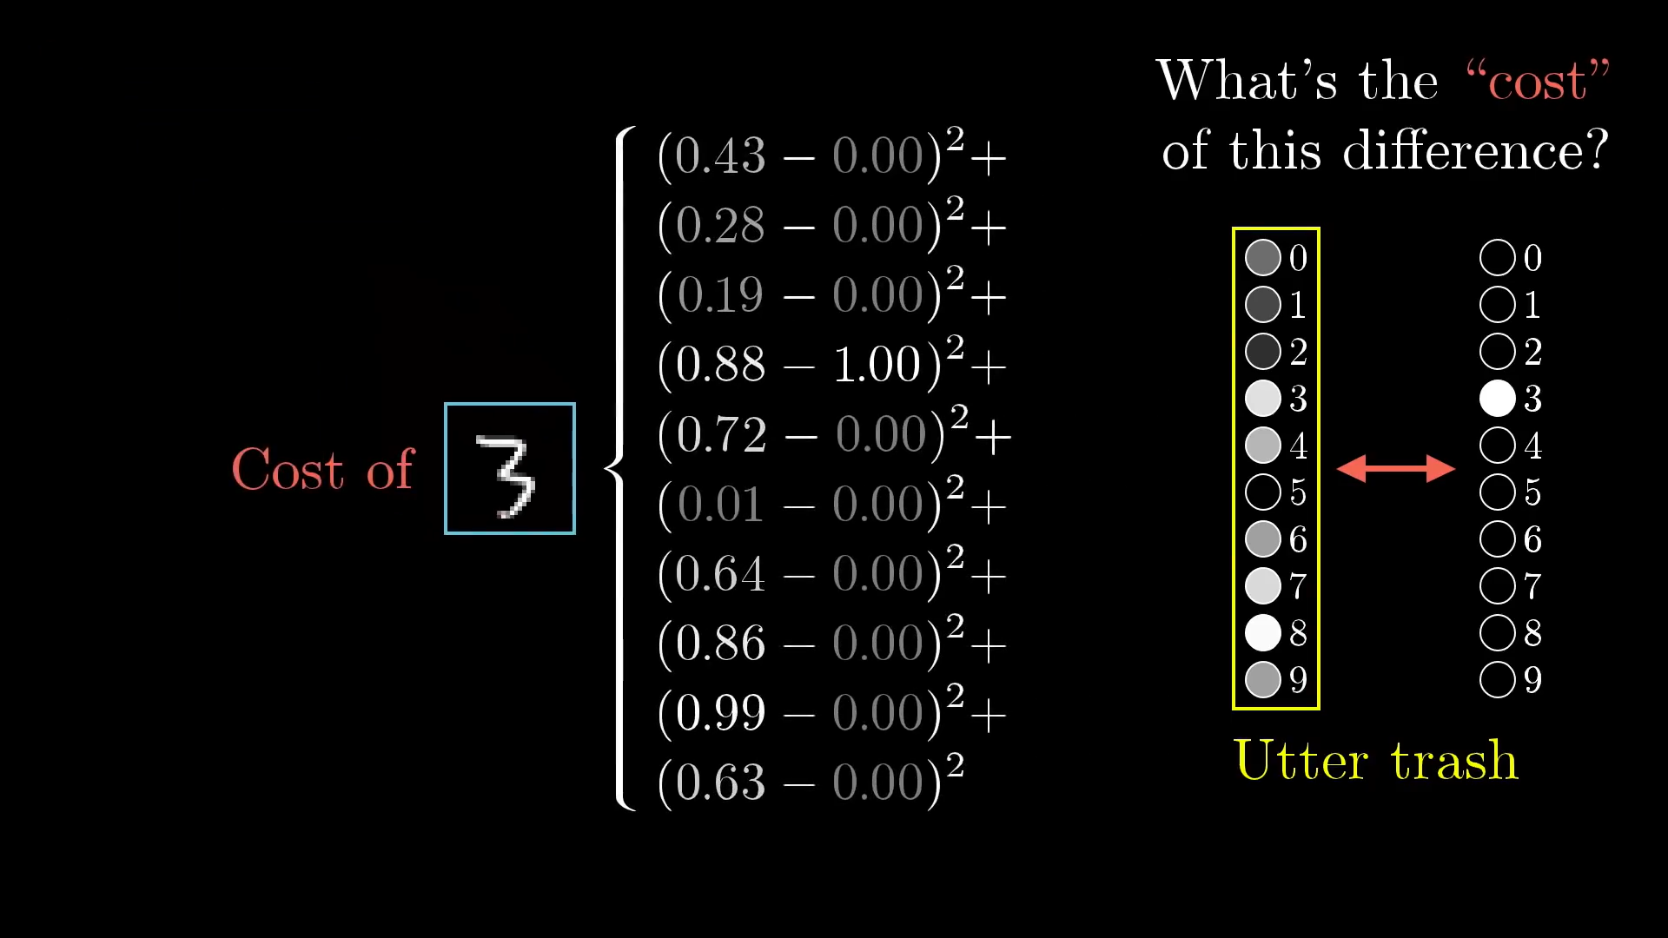

Slide 28
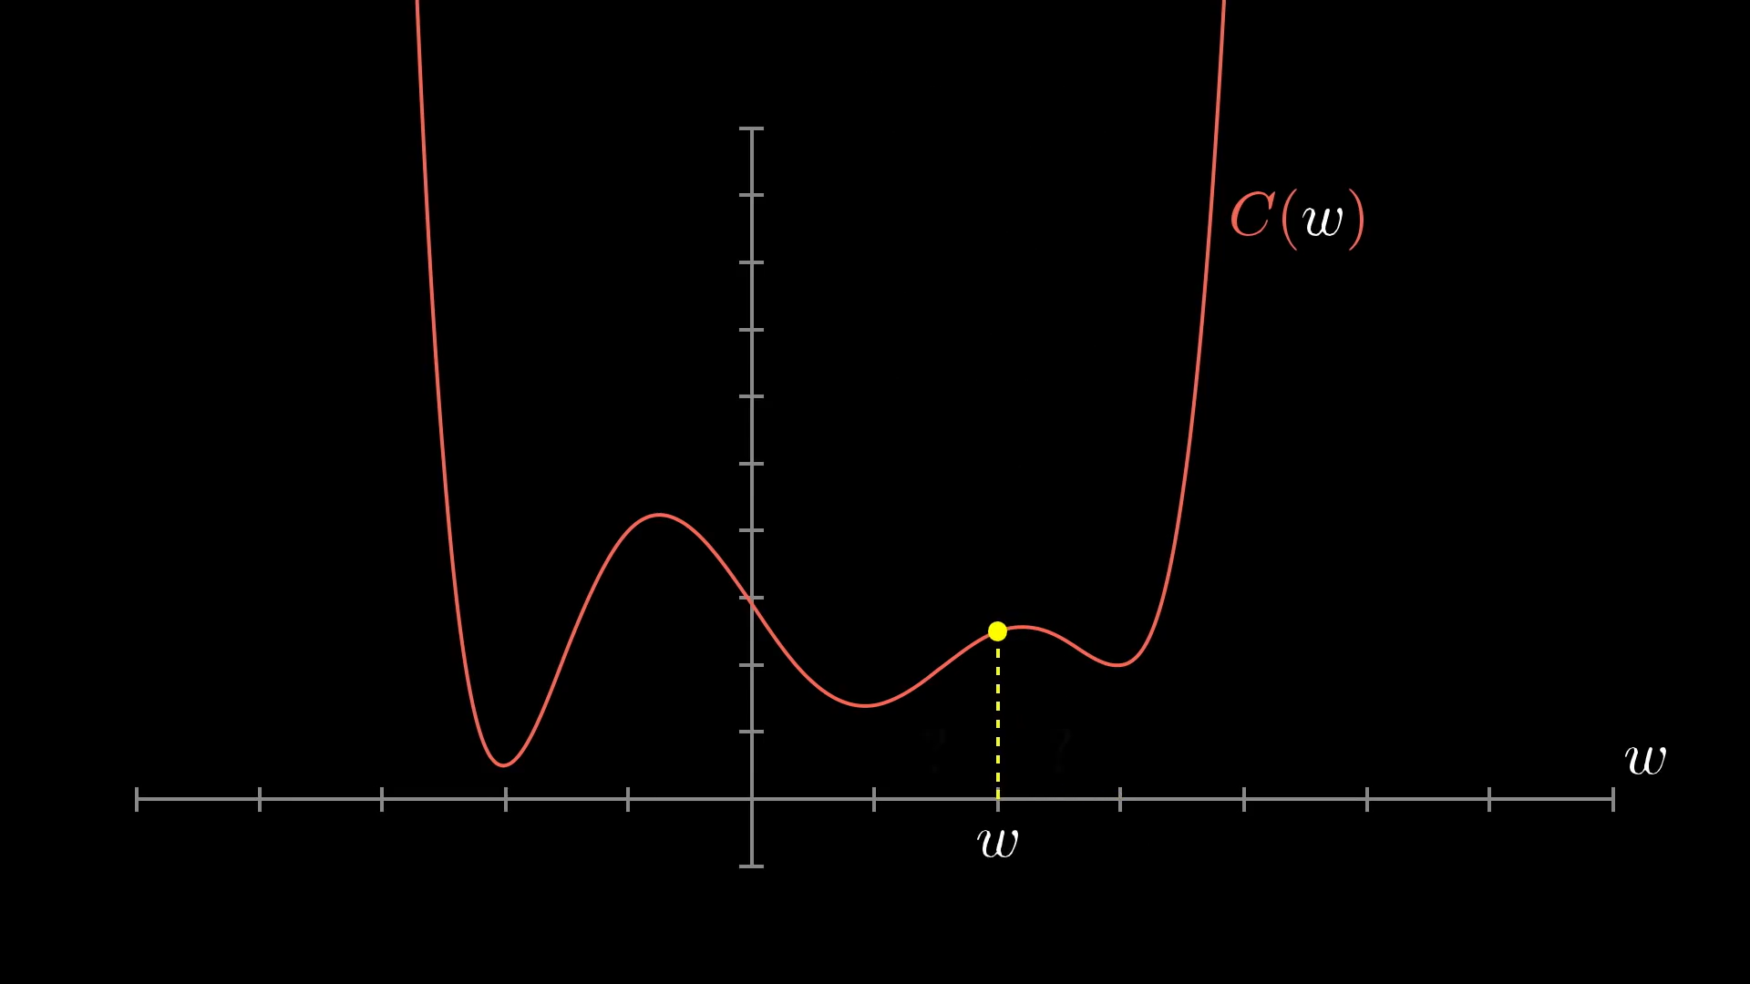

Slide 29
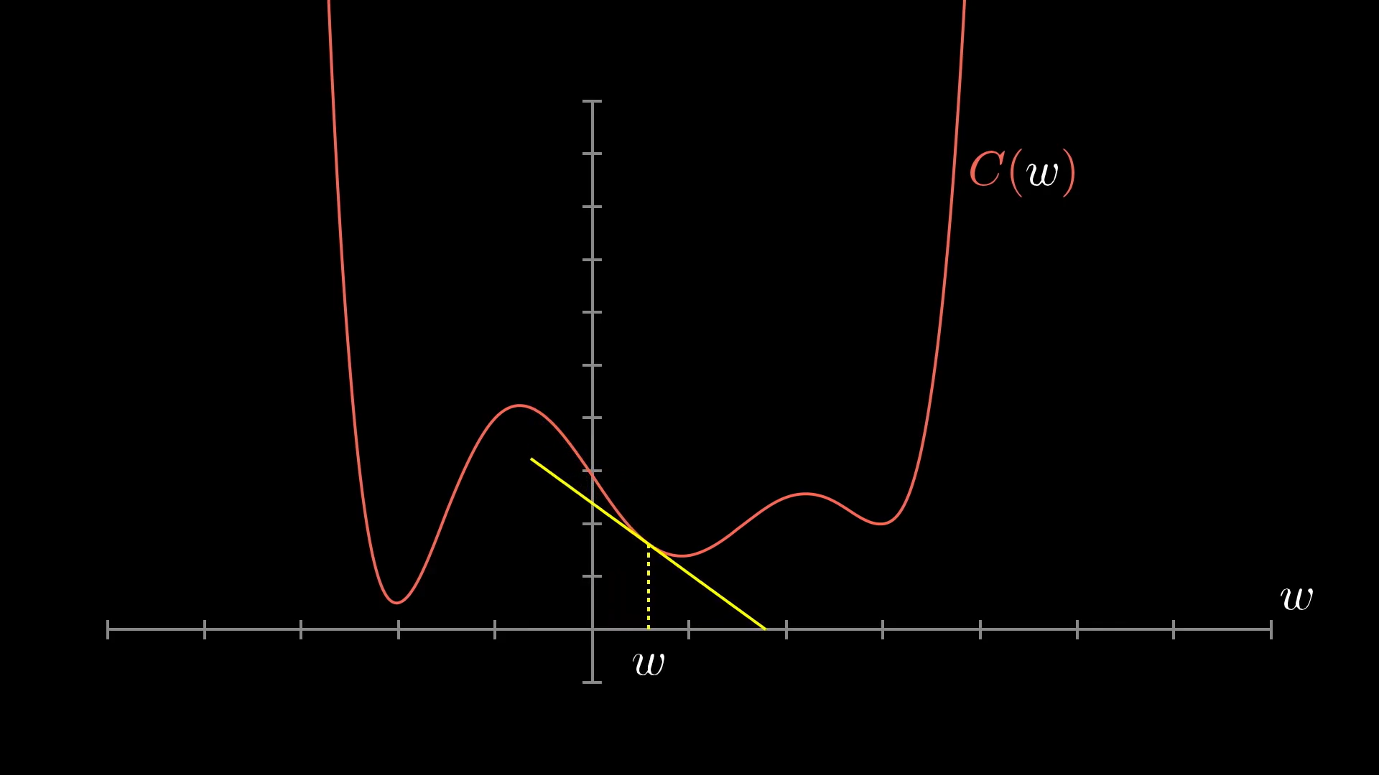

Slide 30
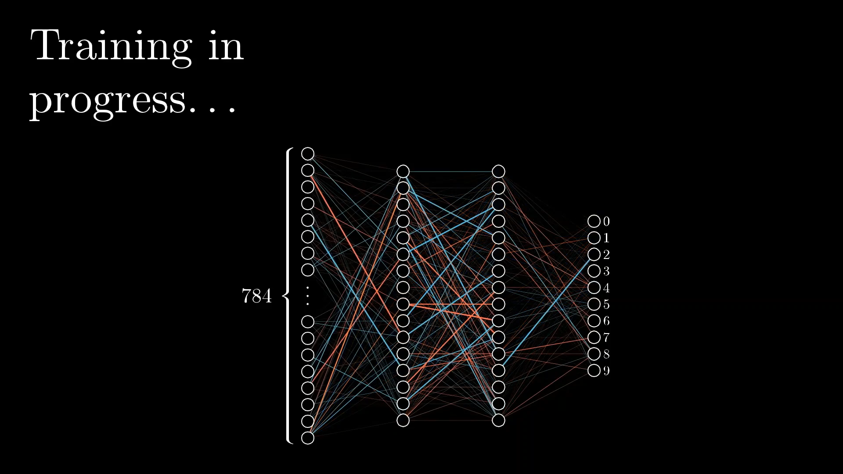

Slide 31
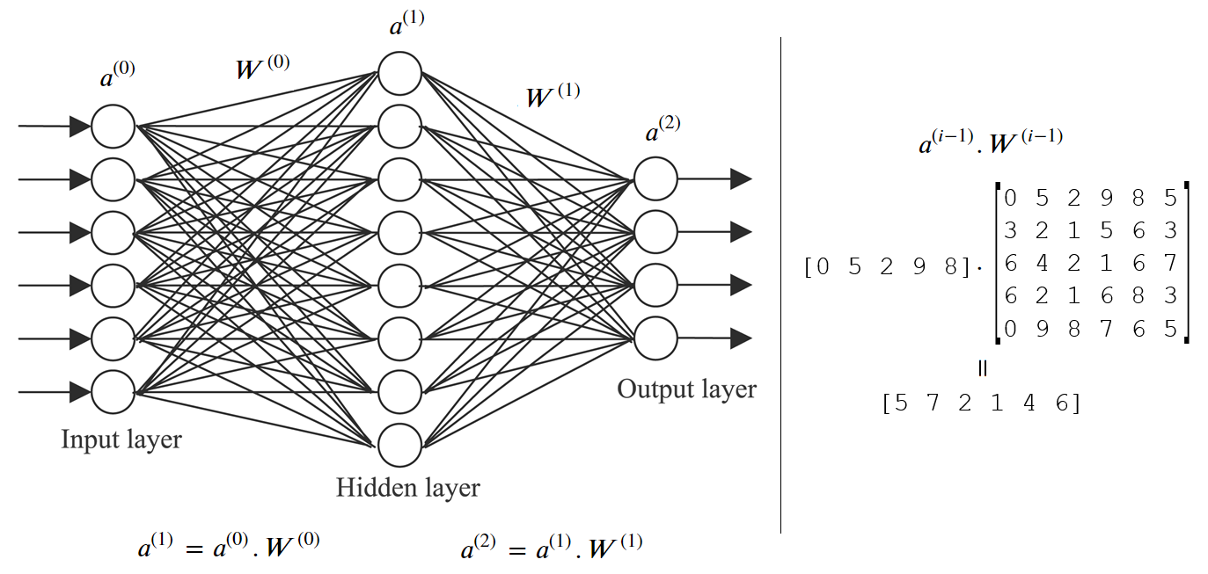
How does it work?

Slide 32
4. What you need to be an ai developer

Slide 33


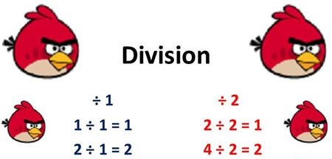
Non-programming skills
English | Domain Knowledge
Math

Slide 34
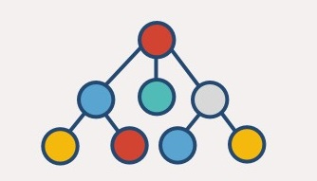
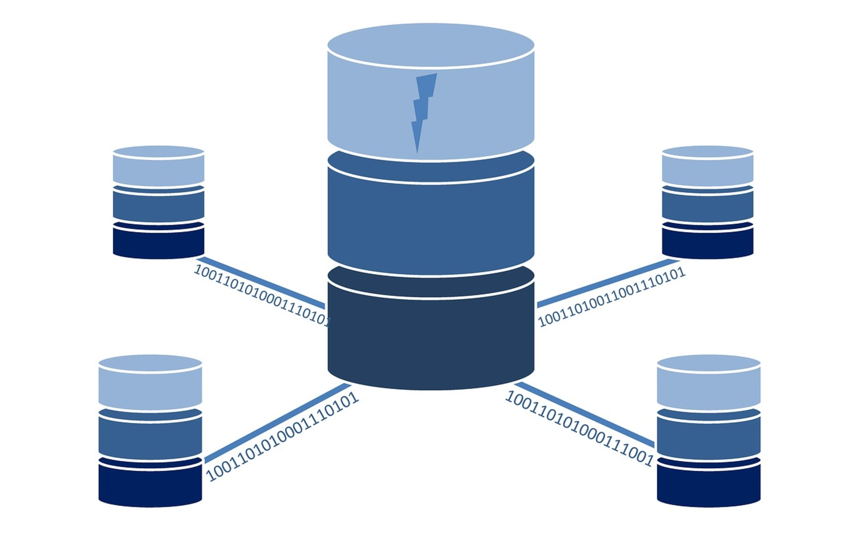

programming skills
Computer Science | Data Modeling
Applying Algorithms | Software Engineering

Slide 35
5. Q & A

Slide 36
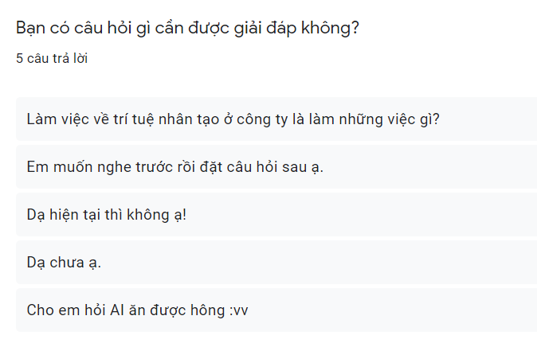

Slide 37
Question 1: Can AI be eaten?
No
Just don’t do that
However, AI can:
Help you to choose what & where to eat
Guide you through cooking orders and recipes
Monitor you eating habit
Guide food transporting and delivery

Slide 38
Question 2: What are careers in ai?
ENGINEER | SCIENTIST
Data Engineer Build & maintain data environment Machine Learning Engineer Apply algorithms Build & maintain ML systems | Data Scientist Analyze, interpret data Research Scientist Find & try solutions

Slide 39
THANK YOU
Hung Nguyen

